Slide 1
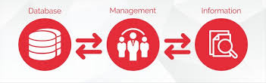
Unit - I Introduction to IT Tools in Business

Slide 2
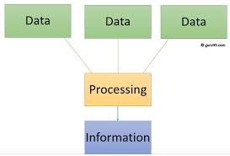
Data - The collection of raw facts and figures is called Data.
Data is an input for computer.
Data is independent.
When data is lost, it can't be reproduced.
Data is meaningless and valueless.
Information – The processed form of data is called Information.
Information is an output from computer.
Information is dependent on data.
When information is lost, it can reproduced from data.
Information is meaningful and valuable.

Slide 3
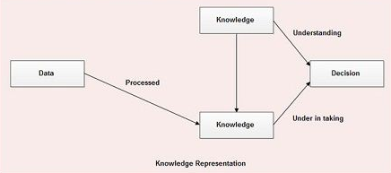
Knowledge - Human mind purposefully organized the information and evaluate it to produce knowledge.
Knowledge is of two types -
Facts based or Information based Knowledge - The knowledge gained from fundamentals and through experiments. The knowledge is derived from the information contained in fundamental science derived from experiments, rules, regulations commonly agreed by experts.
Heuristic Knowledge - It is knowledge of good practice, experience and good judgment like hypothesis. It is the knowledge underlying “expertise”, rules of thumb, rules of good guessing, that usually achieves desired results but do not guarantee them.

Slide 4
Information Technology - The technology involving the development, maintenance, and use of computer systems, software, and networks for the processing and distribution of data.
Uses of Information Technology – Basically Information Technology is the use of technology to solve business computing needs/problems. IT is really an umbrella of different disciplines. For example anything from design, network Administration, computer programming and computer support all fall under the field. IT experts make use of their skills through the support/troubleshooting of basic and complex issues.
Types of Information Technology – Information Technology is a large industry that includes thousands of well known software packages and services. There are some major types of Information Technology.
Video Conferencing
Voice over Internet Protocol (VOIP)
Webcasting

Slide 5
How information technology used in business?
Product Development - Information technology helps businesses to identify the changing customer’s needs more quickly than the traditional research and react strategy.
Globalization - Globalization refers to the integration of markets in the global economy. Information technology helps businesses initially to grow locally and then internationally.
Facilitate Fast Payment Transfer - Nowadays currency transfer between two or more parties digitally is the fastest to settle out any business transaction.
Efficient and Effective Storage - Almost every business organization uses computer for data storage of the business. Computer software like excel and office help in keeping the
Ease of Communication

Slide 6
Uses of Information Technology in Business –
Product Development
Globalization
Facilitate Fast Payment Transfer
Efficient and Effective Storage
Ease of Communication
Competitive Advantage over Competitors
Marketing
MIS (Management Information Systems) – MIS is the acronym for Management Information Systems. MIS is the use of information technology, people, and business processes to record, store and process data to produce information that decision makers can use to make day to day decisions.
Need of MIS – The following are some of the justifications for having an MIS system -
Decision makers need information to make effective decisions. Management Information Systems (MIS) make this possible.

Slide 7
MIS systems facilitate communication within and outside the organization – employees within the organization are able to easily access the required information for the day to day operations.
Record keeping – management information systems record all business transactions of an organization and provide a reference point for the transactions.
Components of MIS - The major components of a typical management information system are -
People - people who use the information system
Data – the data that the information system records
Business Procedures – procedures put in place on how to record, store and analyze data.
Hardware – these include servers, workstations, networking equipment, printers etc.
Software – these are programs used to handle the data. These include programs such as spreadsheet programs, database software etc.

Slide 8
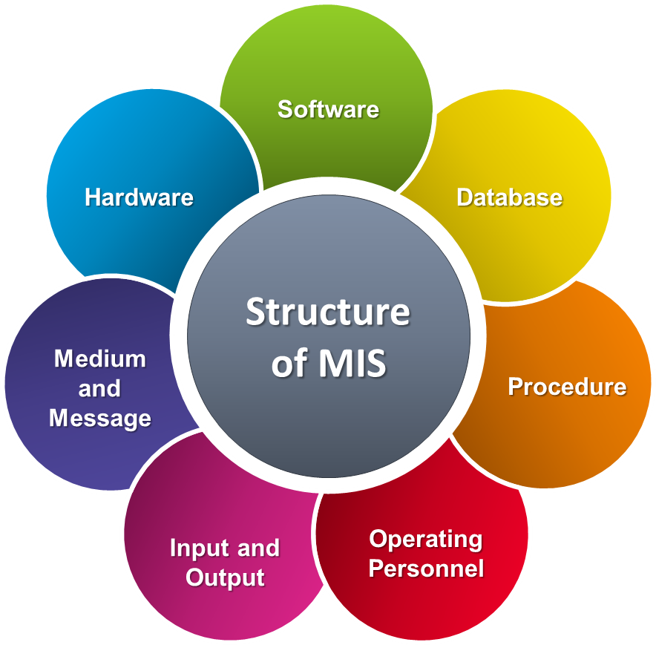

Slide 9
Types of MIS –
Transaction Processing System
Operations Information System
Decision Support System
Expert System
Characteristics -
Management Oriented
Management Directed
Integrated System
Avoid Redundancy
Common Data Flow
Heavy Planning Element
Subsystem Concept
Common Database
Flexibility
Computerization

Slide 10
Function of MIS - It is used to collect the data and present the information to the managers. MIS is the combination of computer and procedures for providing information that manager’s use in making decision.
Collect Data – Data can be obtained from sources within organization and outside world.
Store & Process Data – After creation of the data, a database must be stored and process in the form useful to manager’s data is generally stored to CD ROM or hard disk.
Present Information to Managers – After collection, storing and processing of data, the next step is to present information to the managers.
Process of MIS -The process of MIS starts by knowing MIS objectives. The objectives of MIS should be compatible with the company’s objectives. Management comprises process or activities they are as follows –
Recognition of a problem and an opportunity
Define problem or opportunity
Develop alternative course of action
Decision
Implementation of plan
Control performance against plan

Slide 11
Role of MIS –
MIS ensure that appropriate and relevant data is collected from various sources, processed and is sent further to the needy destination.
It fulfills the need of individual, workgroup and management.
MIS satisfies the diverse need of various systems like query, Analysis, Modeling, DSS.
MIS helps in strategic planning, management control, operational control and transaction processing level.
MIS play important role in information generation, communication, problem identification and decision making administration.
With good MIS support marketing, finance, production, and personal functions increases efficiently.
MIS helps in streamlining of the operations.
MIS creates structured database and therefore saves the time.

Slide 12
System – A system is a collection of components that interact to serve a common goal. There are different types of systems. All types of systems have certain common characteristics. The frameworks for working with the systems are –
Goal
Components
Structure
Behavior
Life Cycle
Boundaries
Characteristics of System –
Management Oriented
Management Directed
Business Driven
Justified
Integrated
Database Approach
7) Distributed System
8) Expandable
9) Flexibility of use
10) Easy to learn
11) Reliable
12) Secure

Slide 13
System View of Business -
The systems approach provides an overall view of an organization’s activities whereby an organization is separated into identifiable subsystems or departments. All such departments are interdependent and perform specific tasks of work which contribute to the organization’s goals. The simplest model of a business system consist of basic elements, they are input, processes, output and feedback.
A systems view regards business operations as systems embedded within a larger environmental setting. It’s an abstract way of thinking, but it has potential value to the manager.
The systems view -
- reduces complexity
- requires good objectives
- emphasizes working together
- acknowledges interconnections
- values feedback
E.g., Computer
Elements of computer are - Monitor, CPU, Printer etc
Basic goals - Data Processing

Slide 14
Types of System -
There is several way of classifying systems that emphasizes the differences. Classification of system is as follows –
Open System – An open system interfaces and interacts with other system. An open system needs to receive feedback to change and continue to exist in its environment.
Example – A marketing system is an open system.
Closed System - A closed system does not exchange the information with its environment. It does not have any connection to the other system.
Example – Research & development of organization, ICU etc.
Physical System – Physical system are tangible entities that may be static or dynamic in operations.
Example the physical parts of the computer center are the computers, desk, chair etc.
Abstract System - Abstract systems are conceptual and non physical entities. They may be formulas of relationship among set of variables or models, software / program.

Slide 15
Deterministic System – A deterministic system works with certainty in predictable manner. The interaction among its subsystem is known in advance. One state of the system determines the next state of the system.
Example – A computer system which works on the principal GIGO.
Probabilistic System - A probabilistic system operates with uncertainty as certain degree of error is always attached with prediction of what the system will do.
Example – A student admission system in a college is probable in nature.
Information System - Information system are a set of people, procedure and resources that collects, transforms and disseminates information in an organization
There are six building block of information system, is the input, output, technology, models, database and control.
Types of Information System - There are two types of information system.
- Operation Information System – It process the data generated by and used in business operation. It is also two types -
Transaction processing System Office Automation System
- Management information System – MIS provide information to support management decision making.
Decision Support System Executive Support System

Slide 16
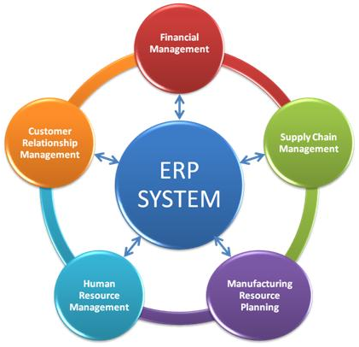
Enterprise Resource Planning (ERP)

Slide 17
What is ERP?
The Full form of ERP is Enterprise Resource Planning.
ERP is a business management software.
It is a suite of integrated application that helps users to store and manage data of their business.
One of the most important activities associated with the implementation of an ERP system is the opportunity to streamline and improve the business operations of an organization through business process re-engineering and the by implementing the best practices and standards.
ERP software is very useful for large organization. It comes in many modules:
Human Resources
Financial Accounting
Supply Chain Management
Customer Relationship Management
Inventory
Purchasing
Project management

Slide 18
Why implement an ERP System?
An ERP is the best option for demonstrating value by providing real-time information to all employees of a corporation across departments.
1. Integrate Financial Information
Enterprise owners want to understand company's overall performance because in numerous situation they may find various versions of the truth. Finance and sales have another version and business units may have their version of the contribution of revenues for the organization. By implementing ERP, they can get a single version of the truth.
2. Standardize and Speed up Manufacturing Processes:
ERP systems come with methods for automating manufacturing process. This helps organizations to speed up and standardize the manufacturing process.
3. Reduce Inventory:
It helps to increase the visibility of the order fulfillment process of any company. It may lead to reduced inventories to make products.
4. Increases and Improves Interaction:
ERP system also helps to increase and improve interaction between customers and suppliers. Moreover, the suppliers can also communicate more seamlessly with sales, marketing, and finance team.

Slide 19
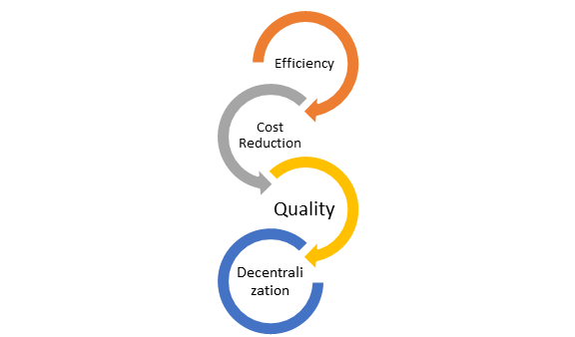
What are Primary Goals for the ERP System?
The goal of any ERP project is to track supply chain actions from inventory purchase, processing, and final shipment.
1. Efficiency
The real-time information flow in ERP system eases the analysis, data, and reporting. It also improves decision-making. It also helps to reduce the need for maintaining multiple databases.

Slide 20
2. Cost Reduction
Cost reduction is vital reason why small and large enterprises invest huge time and resources for implementing ERP systems. It will reduce waste and increase productivity. It also reduces overall production's cost.
3. Quality
Quality improvement is the most important goal of ERP. The software technology helps management to benchmark its quality performance against other manufacturing companies in the same industry.
4. Decentralization
Enterprise resource planning systems can decentralize decision-making process at all level. It also allows users to have real-time access to the same data, such as production status and financial reports.

Slide 21
Benefit of ERP System:
An ERP system is easily scalable so adding new functionality according to the business plan is very easy.
By offering accurate and real-time information ERP software reduces administrative and operations costs.
ERP system improves data quality by improving the underlying processes which help organizations to make better business decisions.
ERP system helps to improve data access with the use of advanced user management and access control.
ERP provides transparency to the organization
Helps to eliminate redundancy in the data management system
Offers a higher level of security by allowing restricting employee's accounts only to the processes.
It helps to helps make reporting easier and more customizable.

Slide 22
Drawback of ERP System:
The up-front cost of the entire implementation can be very high for any small-to-medium-sized businesses.
ERP deployments take a relatively longer amount of time. Sometime it may take 1-3 years to be implemented and be fully functional.
Migration of existing data is very difficult to achieve. That' why Integrating ERP systems with other standalone software systems is equally difficult.
ERP implementations are very difficult in decentralized organizations with different kind of business processes and systems.

